Slide 1

题目 Lesson-02
xx老师& 开课吧人工智能学院课程组
2019.9

Slide 2
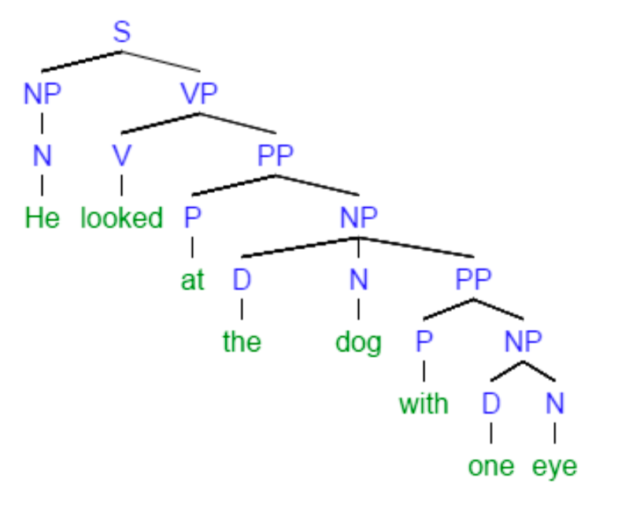
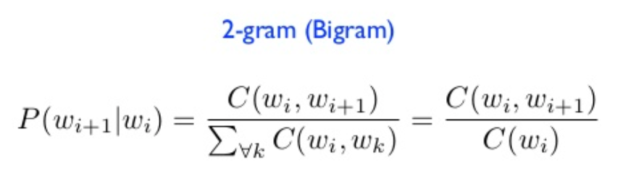
Recap
What we learned in last lecture ?
Rule based learning
Syntax tree
Probability based learning
Probability language model

Slide 3
overview
Search Methods
Breadth-first search
Depth-first search
Optimal search
Machine Learning
Introduction
Optimization (Gradient descent)
Linear regression

Slide 4
Search Methods
Reference: Artificial Intelligence: A Modern Approach (3th) Chapter 3

Slide 5
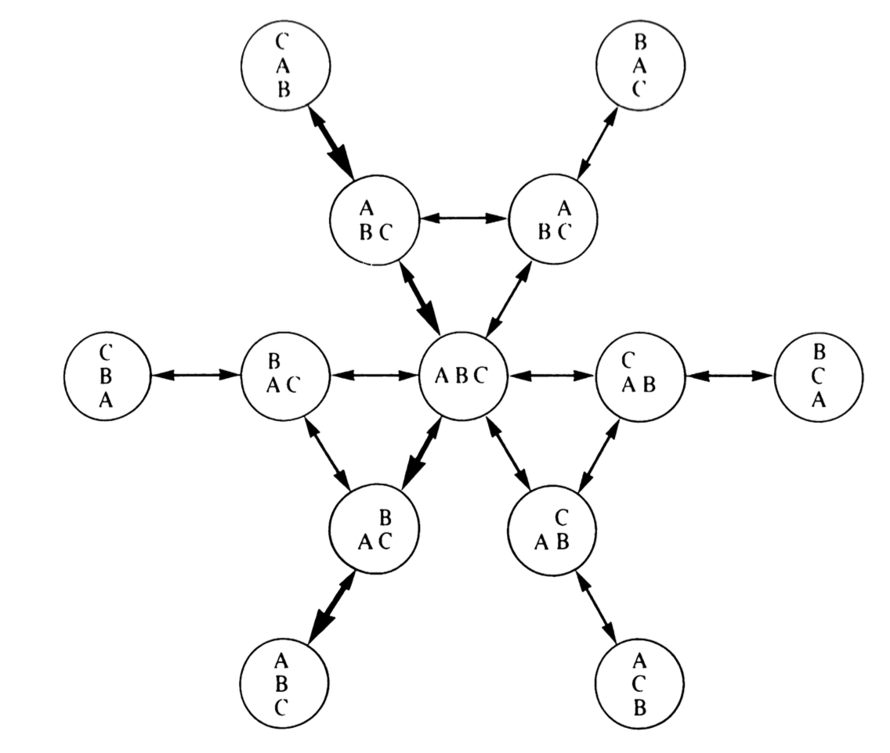
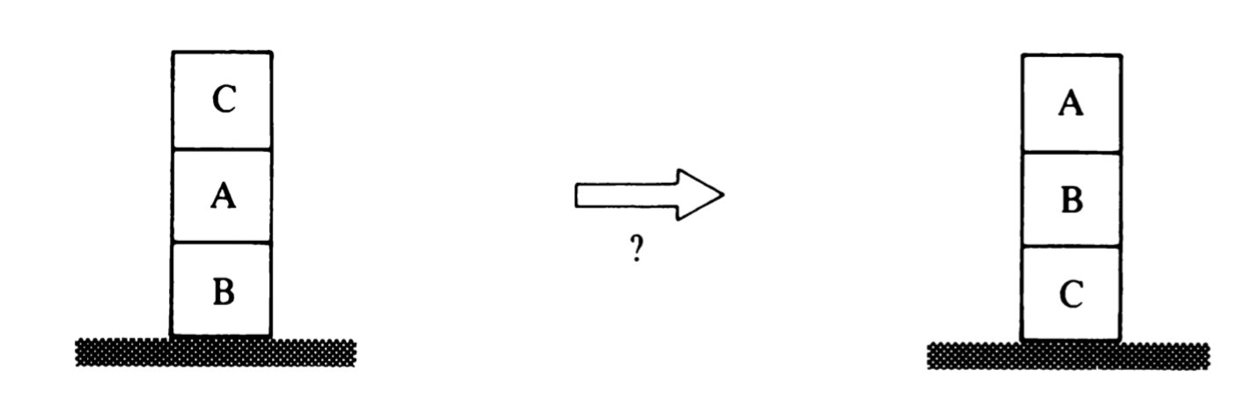
Solving problems by searching
Example 1. A blocks rearrangement problem

Slide 6
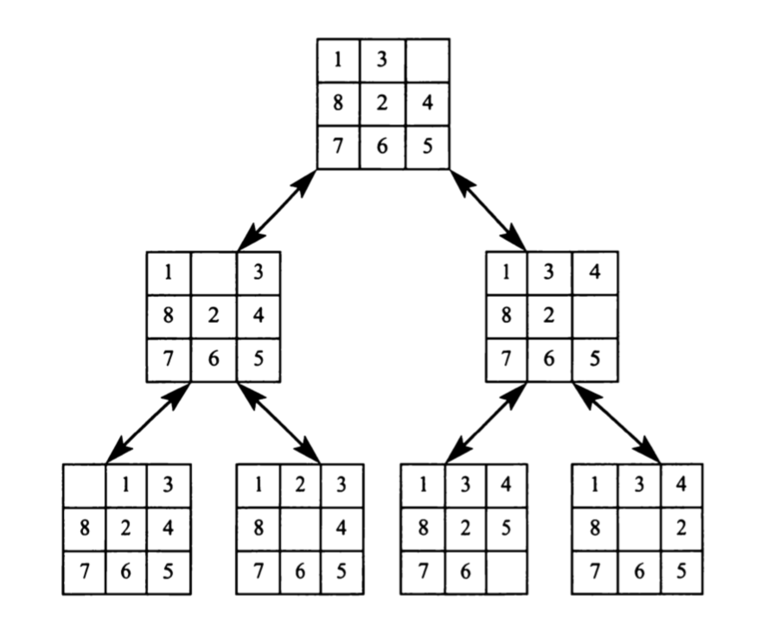
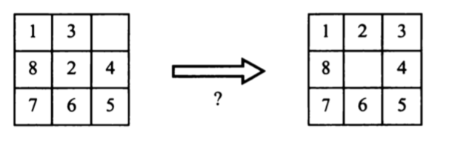
Example 2. Eight puzzles

Slide 7
Find a path from S to G
A
B
C
S
G
D
E
F
S
A
D
B
D
A
E
C
E
E
B
B
F
D
F
B
F
C
E
A
C
G
G
C
G
F
G

Slide 8
Breadth-first search
Move downwards, level by level, until goal is reached.
(S)
(SA,SD)
(SD,SAB,SAD)
(SAB,SAD,SDA,SDE)
(SAD,SDA,SDE,SABC,SABE)
(SDA,SDE,SABC,SABE,SADE)
(SDE,SABC,SABE,SADE,SDAB)
(SABC,SABE,SADE,SDAB,SDEB,SDEF)
(SABE,SADE,SDAB,SDEB,SDEF)
(SADE,SDAB,SDEB,SDEF,SABED,SABEF)
(SDAB,SDEB,SDEF,SABED,SABEF,SADEB,SADEF)
(SDEB,SDEF,SABED,SABEF,SADEB,SADEF,SDABC,SDABE)
(SDEF,SABED,SABEF,SADEB,SADEF,SADABC,SDABE,SDEBA,SDEBC)
(SABED,SABEF,SADEB,SADEF,SADABC,SDABE,SDEBA,SDEBC,SDEFG)
S
A
D
B
D
A
E
C
E
E
B
B
F
D
F
B
F
C
E
A
C
G
G
C
G
F
G

Slide 9
Depth-first search
1. Select a child
convention: left-to-right
2. Repeatedly go to next child, as long as possible.
3. Return to left-over alternatives (higher-up) only when needed.
S
A
D
B
D
A
E
C
E
E
B
B
F
(S)
(SA,SD)
(SAB,SAD,SD)
(SABC,SABE,SAD,SD)
(SABE,SAD,SD)
(SABED,SABEF,SAD,SD)
(SABEF,SAD,SD)
(SABEFG,SAD,SD)
D
F
B
F
C
E
A
C
G
G
C
G
F
G

Slide 10


Test your understanding
S
A
D
B
A
D
B
A
C
E
S
C
E
E
B
G
B
F
D
F
D
E
F
B
F
C
E
A
C
G
G
C
G
F
G
1. What is the path from S to G using BFS ?
S -> D -> E -> F -> G
2. What is the path from S to G using DFS ?
S -> A -> B -> E ->F -> G

Slide 11
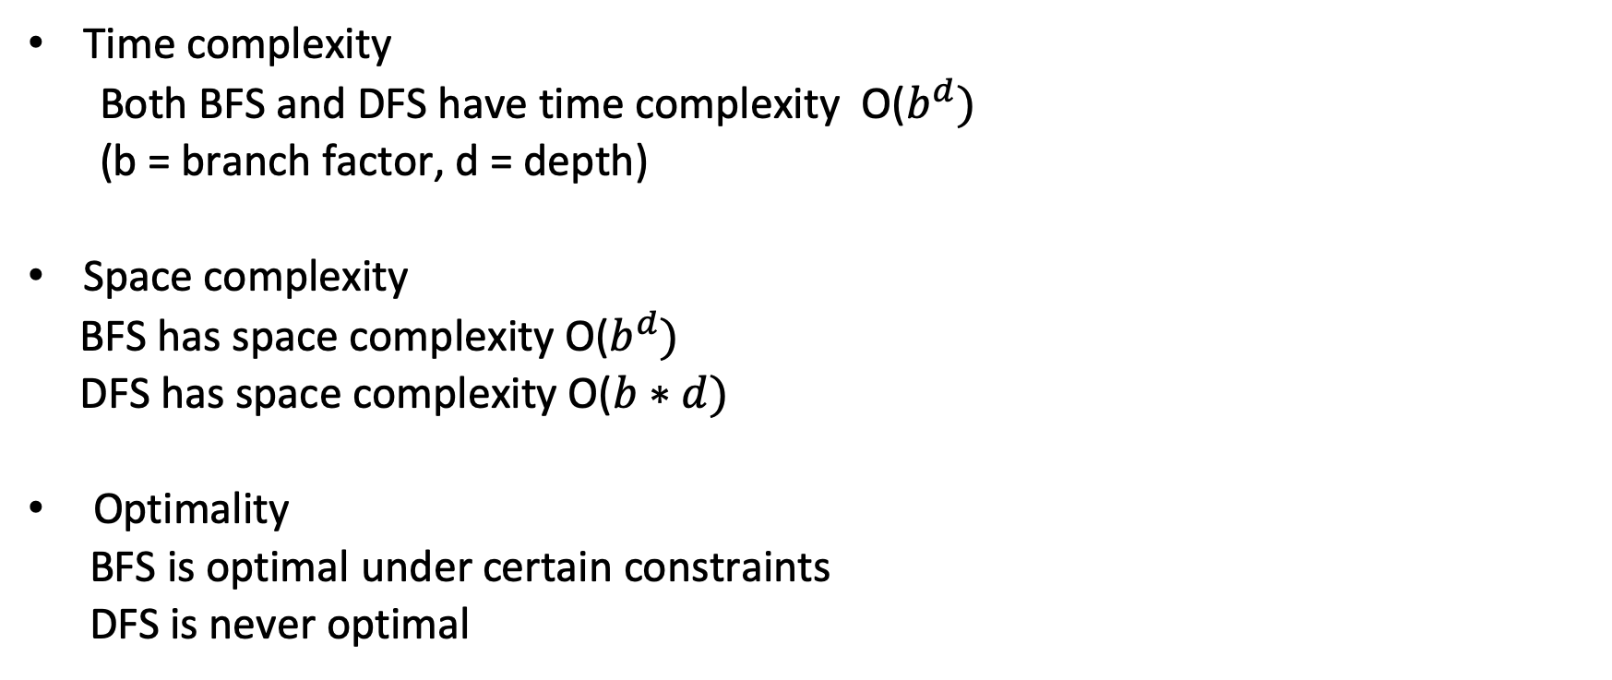
Comparisons
Time complexity
Both BFS and DFS have time complexity O($b^{d})$
(b = branch factor, d = depth)
Space complexity
BFS has space complexity O($b^{d})$
DFS has space complexity O($b∗d)$
Optimality
BFS is optimal under certain constraints
DFS is never optimal

Slide 12
Optimal search
The required optimal conditions of BFS
1. All costs between two nodes are positive or zero.
2. Sort the list used to maintain the searching history in every iteration.
==> Under these two conditions, BFS is guaranteed to find optimal result

Slide 13
A* search
Similar to BFS under the optimal conditions.
Differences :
1. It sorts the list by the sum of the cost for initial node to current node and the estimated cost from current node to the goal.
total = cost(s,c) + estimated_cost(c,g)
2. In every iteration, it check all path and prune some paths that will never be the optimal results.
A
10.4
B
6.7
C
4
S
11
8.9
G
D
E
6.9
F
3

Slide 14

Let’s coding

Slide 15
Machine Learning

Slide 16
AI Domain
Machine learning applications

Slide 17
What is machine learning ?
Tom Mitchell, 1996: Machine learning is the study of how to make programs improve their performance on certain tasks from (own) experience.
Performance = speed, accuracy…
Experience = earlier observation = data
Conclusion: use data to learn a model that has good performance on unseen data.

Slide 18
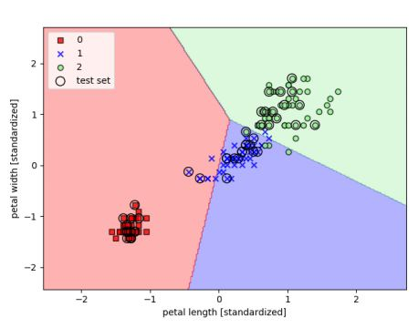
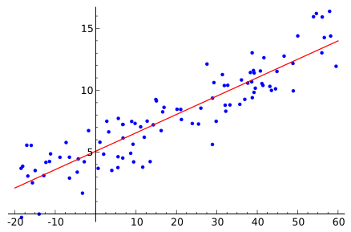
Two types of ML problems
Regression : Learn a function to fit the data
Classification: Learn a hyperplane that can separate data of different categories

Slide 19
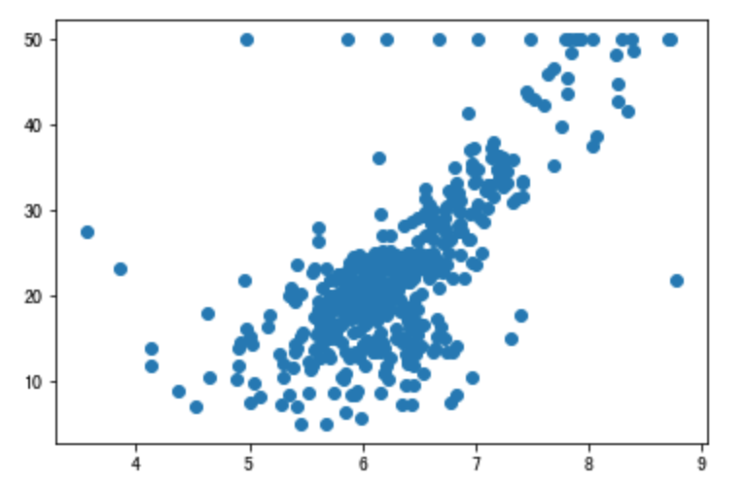
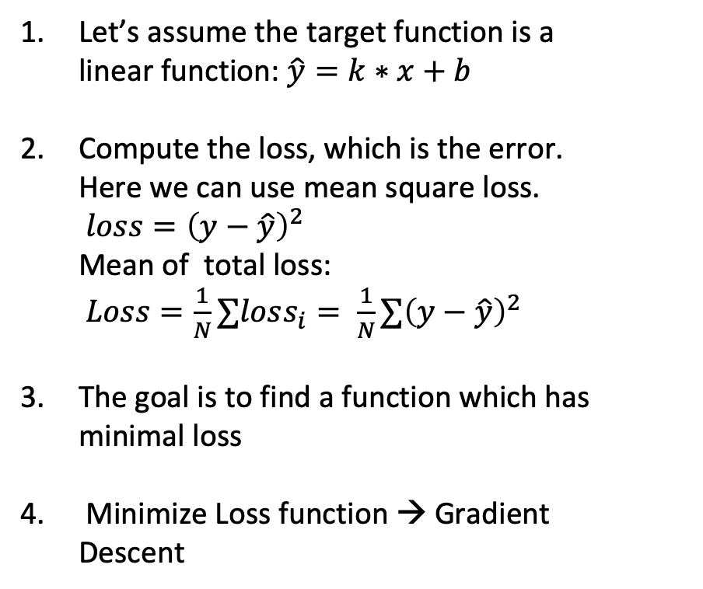
Linear regression from 0 to 1.
Let’s assume the target function is a linear function: $\hat{y}=k∗x+b$
Compute the loss, which is the error. Here we can use mean square loss.
$loss={\left(y−\hat{y}\right)}^{2}$
Mean of total loss:
$Loss=\frac{1}{N}∑loss_{i}= \frac{1}{N}∑{\left(y−\hat{y}\right)}^{2}$
The goal is to find a function which has minimal loss
Minimize Loss function → Gradient Descent

Slide 20
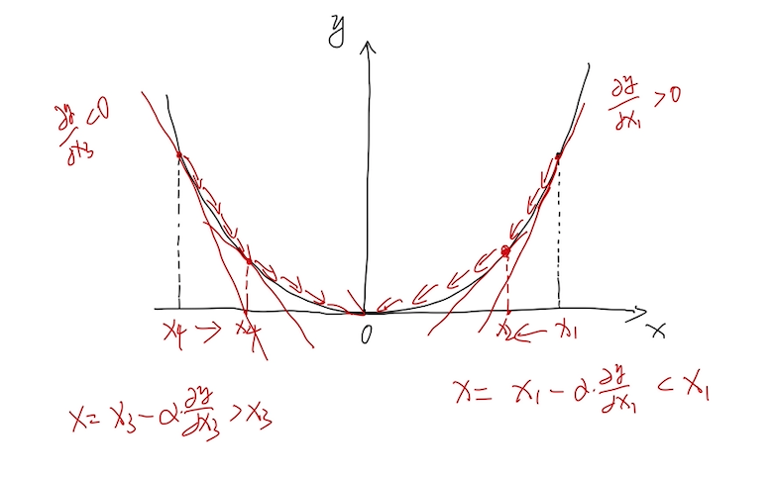
Why gradient descent ?

Slide 21
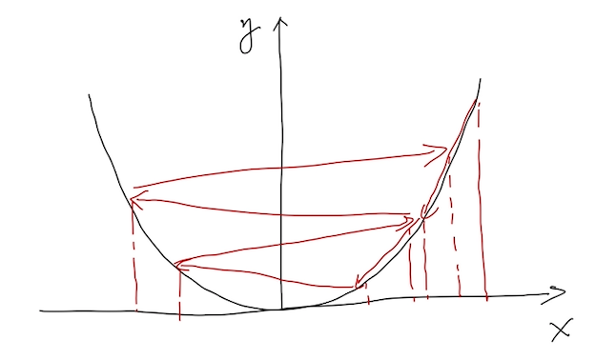
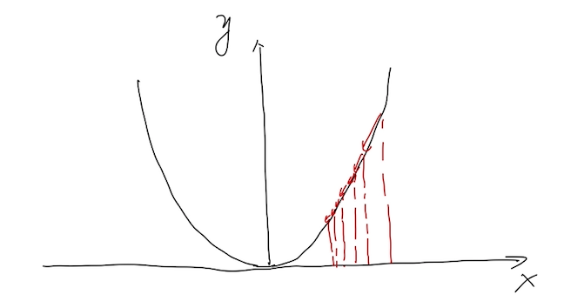
Test your understanding
What will happen in GD if the learning rate is too big ?
What will happen in GD if the learning rate is too small ?

Slide 22
Let’s coding

